Slide 1
Artificial Intelligence (Machine Learning & Deep Learning)
{
Introduction to NLP
}
...

Slide 2
Contents of Day 25
Recap & introduction | Moving from Python OOP to Data Science. Why AI needs data.
Core Thoery | Introduction to NLP, Real-World Use Cases, and Pipeline Architectures. Syntax, Semantics, Pragmatics, and Discourse (The NLP Evolutionary Curve). Data Pre-processing: Noise Removal, Tokenization, and Normalization. Toolkits: Introduction to NLTK vs. spaCy (Setup and Model Management).
Lab Practice | Practical coding tasks implementing method
Advance Lab | Understanding the logic with real world examples.
Wrap-up & Q&A | Debugging tips along with Q&A and suggestion

Slide 3
What is NLP? - The Big Picture
Computers understand numbers. Humans speak language.
NLP is the bridge between the two.
NLP stands for Natural Language Processing.
It teaches machines to:
* Read and understand text
* Interpret meaning behind words
* Generate human-like responses
Real world examples you use daily:
* Google Search → understands your query
* Gmail spam filter → reads your emails
* ChatGPT → generates language like a human
NLP is the reason AI can talk to us.

Slide 4
The Four Levels of Language Understanding
To understand language, a machine must process it at 4 levels:
Level 1: Syntax → Grammar and sentence structure
Level 2: Semantics → Meaning of words and sentences
Level 3: Pragmatics → Meaning in context
Level 4: Discourse → Understanding across multiple sentences
Think of it like building a house:
Syntax = the structure (walls and beams)
Semantics = the rooms (what each part means)
Pragmatics = how people actually live in it
Discourse = the whole neighborhood

Slide 5
Syntax - The Grammar Rules
Syntax studies the rules that govern sentence structure.
It answers: Is this sentence grammatically correct?
Example:
* Correct: "The cat sat on the mat."
* Incorrect: "Sat mat the on cat the."
Key NLP task - Parsing:
* Breaking a sentence into its grammatical parts
* Subject, Verb, Object, etc.
Why it matters for NLP:
* A machine needs structure to process language
* Without syntax rules, text is just random words
* Parsing helps extract who did what to whom

Slide 6
Syntax - Parse Trees
A ParseTree shows the grammatical structure visually.
Example sentence: "The dog chased the cat."
Tree structure:
* S (Sentence)
* NP (Noun Phrase): "The dog"
* VP (Verb Phrase): "chased the cat"
* V (Verb): "chased"
* NP: "the cat"
Two types of parsing in NLP:
* Constituency Parsing → groups words into phrases
* Dependency Parsing → shows which words depend on others
SpaCy can generate dependency parses automatically.

Slide 7
Semantics - What Does It Mean?
Semantics is the study of meaning in language.
Syntax tells us IF a sentence is correct.
Semantics tells us WHAT the sentence means.
Example - Syntactically correct but semantically weird:
* "Colorless green ideas sleep furiously." (Noam Chomsky)
* Grammatically perfect → Meaningless
Key semantic tasks in NLP:
* WordSenseDisambiguation → "bank" (river or money?)
Word Sense Disambiguation (WSD) is a core Natural Language Processing (NLP) task that determines which meaning (sense) of a polysemous word is used in a specific context. By analyzing surrounding words.
* Semantic Similarity → "car" and "automobile" mean the same
* Semantic Role Labeling → who did what to whom
Challenge: Same word, different meanings (polysemy).

Slide 8
Semantics - Word Meaning in Vectors
Modern NLP represents meaning using vectors.
A vector is just a list of numbers.
The big idea: Similar words have similar vectors.
Famous example (Word2Vec):
king - man + woman = queen
This means the model learned:
* king and queen share a "royalty" dimension
* man and woman share a "gender" dimension
* The relationship between them is captured mathematically
This is called a WordEmbedding.
It converts human meaning into numbers a machine can use.

Slide 9
Pragmatics - Language in Context
Pragmatics studies how context affects meaning.
Same words → completely different meaning depending on situation.
Example 1 - Sarcasm:
* "Oh great, another bug in the code."
* Literal meaning: positive
* Actual meaning: frustration
Example 2 - Indirect speech:
* "Can you pass the salt?"
* Literal: asking about ability
* Actual meaning: please pass the salt
Why it's hard for machines:
* Requires real-world knowledge
* Requires understanding tone and culture
* Context changes everything — machines struggle here

Slide 10
Discourse - Beyond One Sentence
Discourse is the study of language across multiple sentences.
A single sentence is easy. A full paragraph is harder.
Challenge - Coreference:
* "Ali went to the store. He bought bread."
* Who is He? → Ali
* The machine must link "He" back to "Ali"
This is called Coreference Resolution.
Other discourse tasks:
* Coherence → Does the paragraph make logical sense?
* Discourse markers → "however", "therefore", "because"
* Topic modeling → What is the overall document about?
All modern LLMs (like ChatGPT) solve discourse at massive scale.

Slide 11
NLP Progress - A Brief History
NLP did not start with ChatGPT. It has a long journey.
1950s - Rule-based systems:
* Humans wrote grammar rules manually
* Brittle and limited
1990s - Statistical NLP:
* Learn patterns from data
* HMMs, Naive Bayes, n-grams
2013 - Word2Vec:
* Words as vectors, meaning in numbers
2017 - Transformers:
* "Attention is All You Need" paper
* Completely changed NLP
2020-Now - Large Language Models:
* GPT, BERT, LLaMA, Claude
* Human-level language understanding

Slide 12
NLP Future Directions
NLP is one of the fastest growing fields in AI.
Current trends:
* LLMs (Large Language Models) are becoming multimodal
* Combining text + images + audio + video
Upcoming challenges:
* Hallucination → models generate false but confident answers
* Bias in language models
* Low-resource languages (Urdu, Punjabi, etc.)
Future directions:
* Real-time reasoning and planning
* Multilingual models for all world languages
* Smaller, efficient models (run on phone)
* Explainable NLP → WHY did the model say that?
Pakistan-specific opportunity: Urdu NLP is still underdeveloped!

Slide 13
Why Pre-process Text Data?
Raw text is messy. Machines need clean input.
Example raw input:
"HELLO!!! This is sooo GREAT... right?? 😊 #nlp"
Problems in raw text:
* Extra whitespace and weird formatting
* Uppercase vs lowercase inconsistency
* Punctuation that adds no meaning
* Stopwords like "is", "the", "a" (useless for analysis)
* Emojis, HTML tags, special characters
Pre-processing goal:
* Keep only the meaningful parts
* Reduce noise so the model learns the right patterns
Rule of thumb: Garbage in → Garbage out.
Good pre-processing = better model performance.

Slide 14
The NLP Pre-processing Pipeline
Text data follows a pipeline before entering any model.
Step 1: Lowercasing
* "Hello" and "hello" are the same word → unify them
Step 2: Tokenization
* Split text into individual words/tokens
Step 3: Remove Punctuation
* Commas, periods, exclamation marks → usually useless
Step 4: Remove Stopwords
* Filter out "the", "is", "at", "which", "on"
Step 5: Stemming or Lemmatization
* "running" → "run", "studies" → "study"
Order matters! Always lowercase BEFORE tokenizing.

Slide 15
Stopwords - What and Why
Stopwords are common words that carry almost no meaning.
Examples: "the", "a", "is", "in", "on", "and", "of"
Why remove them?
* They appear in EVERY document
* They don't help distinguish one document from another
* Removing them reduces noise and speeds up processing
Example - Before stopword removal:
"The students are learning in the classroom today."
After stopword removal:
"students learning classroom today"
The meaning is preserved. The noise is gone.
NLTK provides a built-in stopwords list for 20+ languages.

Slide 16
Stemming vs Lemmatization
Both reduce words to their base form. But differently.
Stemming (fast, rough):
* Cuts off word endings using rules
* "running" → "run"
* "studies" → "studi" (not a real word!)
* Tool: PorterStemmer in NLTK
Lemmatization (slow, accurate):
* Uses dictionary to find actual root word
* "running" → "run"
* "better" → "good" (understands context)
* Tool: WordNetLemmatizer in NLTK / SpaCy
Which to use?
* Stemming → fast prototypes, speed matters
* Lemmatization → production systems, accuracy matters

Slide 17
Introduction to NLTK (classic python nlp library)
import nltk
from nltk.corpus import stopwords
from nltk.tokenize import word_tokenize
# Download necessary NLTK data
(only need to run this once)
nltk.download('punkt')
nltk.download('stopwords')
nltk.download('punkt_tab')
# Get English stopwords
stop_words = set(stopwords.words('english'))
# cleaned_text
cleaned_data = "Hello World This is some text with HTML tags URLs like and numbers like It also has extra spaces and special characters"
# Tokenize the cleaned text
word_tokens = word_tokenize(cleaned_data)
# Remove stopwords
filtered_sentence = [w for w in word_tokens if not w.lower() in stop_words]
print("Original cleaned text:",cleaned_data)
print("Tokenized text:", word_tokens)
print("Text after stopword removal:",filtered_sentence)
NLTK = Natural Language Toolkit.
The classic Python library for NLP — built for teaching.
Install: pip install nltk
What NLTK gives you:
* Tokenizers → split text into words or sentences
* Stopword lists → 20+ languages
* Stemmers and Lemmatizers
* POS Taggers → label each word's grammar role
* Corpora → built-in text datasets for practice
Best for:
* Learning NLP concepts step by step
* Understanding each stage of the pipeline manually
* Academic and educational use
NLTK makes the invisible visible
— perfect for class demos.

Slide 18
Introduction to SpaCy
SpaCy is an open-source software library for advanced natural language processing, written in Python and Cython. It's designed specifically for production use, offering impressive speed and efficiency for tasks like tokenization, named entity recognition, part-of-speech tagging, dependency parsing, and more. Unlike NLTK, which is often used for teaching and research, SpaCy aims to provide a streamlined experience for building real-world NLP applications.
SpaCy = industrial-strength NLP library. Built for real production systems, not just demos.
1st Install: pip install spacy. | Then download lang: python -m spacy download en_core_web_sm
nlp = spacy.load('en_core_web_sm’) | then pass clean data => doc = nlp(cleaned_text)
What SpaCy gives you:
* Lightning fast tokenization and parsing
* Named Entity Recognition (NER) built-in // NLP technique that automatically identifies and classifies key information with in unstructured text into predefined categories like names, organizations, locations, dates values. It transforms raw text into structured data.
* Dependency parsing and POS tagging //Dependency parsing => A syntactic analysis technique that identifies grammatical relationships between words in a sentence, establishing "head-dependent" links to form a tree structure.
Part-of-Speech (POS) tagging in NLP: is the process of marking up words in a text as corresponding to a particular part of speech (noun, verb, adjective, etc.) based on its definition and context.
* Pre-trained language models
Best for:
* Real projects and freelance work
* When speed and accuracy both matter
* Building NLP APIs and pipelines
SpaCy wraps the whole pipeline into one clean object.
One line of code does what NLTK needs 10 lines to do.

Slide 19
NLTK vs SpaCy - Side by Side
Both are Python libraries. Different philosophy.
NLTK:
* Step-by-step, manual control
* Great for learning each concept
* Slower but transparent
* Best for: students, researchers
SpaCy:
* Automated pipeline, production-ready
* Great for building real systems
* Faster and more accurate
* Best for: developers, industry
Recommendation for this course:
* Learn concepts with NLTK first
* Then see SpaCy do it automatically
* Both are important to know
Think: NLTK = teaching kitchen. SpaCy = restaurant kitchen.

Slide 20
Noise Removal - Putting It All Together
Real text data contains many types of noise.
Common noise sources:
* HTML tags: <b>hello</b> → should be just "hello"
* URLs: https://google.com → usually remove
* Numbers: often irrelevant unless context matters
* Emojis and special characters: 😊 → remove or convert
* Extra whitespace: "hello world" → "hello world"
* Repeated characters: "sooooo good" → "so good"
Python regex handles most of these:
import re
text = re.sub(r'http\S+', '', text) # remove URLs
text = re.sub(r'[^a-zA-Z\s]', '', text) #keep only letters
The cleaner the input → the smarter the model.
import re
def remove_noise(text):
# Remove HTML tags (if any)
text = re.sub(r'<.*?>', '', text)
# Remove URLs
text = re.sub(r'https?://\S+|www\.\S+', '', text)
# Remove mentions and hashtags
text = re.sub(r'@\w+|#\w+', '', text)
# Remove numbers
text = re.sub(r'\d+', '', text)
# Remove punctuation and special characters, keeping alphanumeric and spaces
text = re.sub(r'[^\w\s]', '', text)
# Replace multiple spaces with a single space
text = re.sub(r'\s+', ' ', text).strip()
return text
# Example usage
noisy_text = "Hello World! This is some text with <br> HTML tags, URLs like https://example.com, @mentions, #hashtags, and numbers like 123. It also has extra spaces and special characters!!!"
cleaned_text = remove_noise(noisy_text)
print("Original text:", noisy_text)
print("Cleaned text:", cleaned_text)

Slide 21
What Do NLTK and SpaCy Actually Output?
["student", "learn"] → clean, structured data, ready to learn from
Pre-processing is not the destination. It is the starting point.
NLTK and SpaCy produce structured outputs:
* Clean token lists → ["student", "learn", "nlp", "today"]
* POS tags → [("student", "NN"), ("learn", "VB")]
* Named Entities → [("Karachi", "GPE"), ("Google", "ORG")]
* Dependency trees → which word depends on which
* Lemmatized forms → ["run", "study", "good"]
These outputs answer one question for the model:
"What are the meaningful units in this text?"
Without this step, a model sees:
"The students are learning!!!" → messy, inconsistent, noisy
With this step, it sees:
["student", "learn"] → clean, structured, ready to learn from

Slide 22
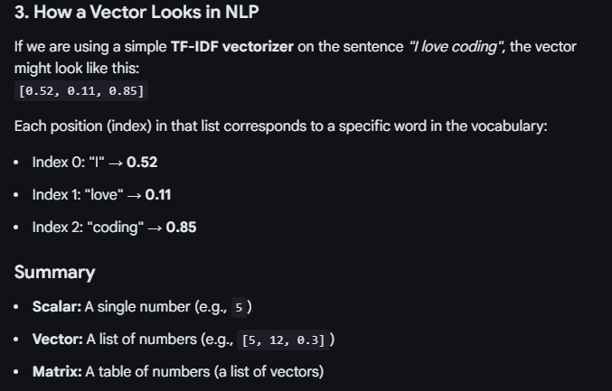
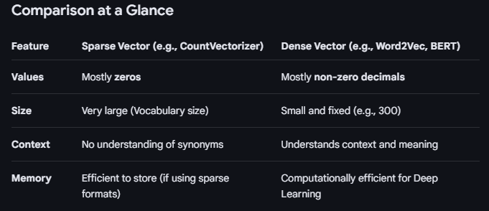
What is Vector, Dense Vector ?
In NLP and DS, a vector is simply an ordered list of numbers that represents a piece of information (like a word or a document).
Think of a vector as a coordinate in a multi-dimensional map.
In NLP, a dense vector is a numerical representation where most (or all) of the values are non-zero.

Slide 23
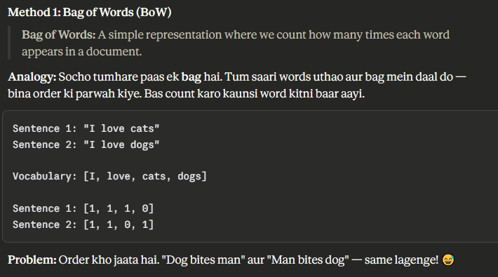
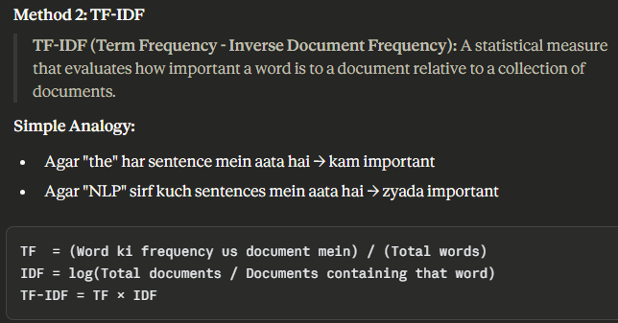
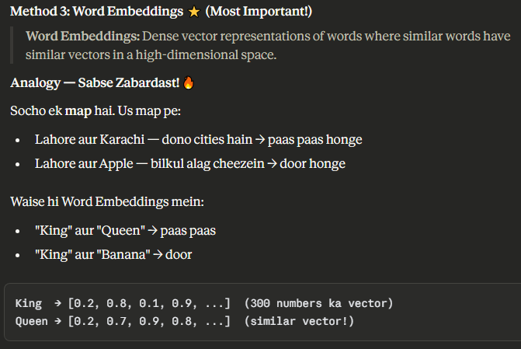
From Tokens to Numbers - Vectorization
Models cannot read tokens. They only understand numbers.
After NLTK/SpaCy cleans the text, the next step is vectorization.
Method 1 - Bag of Words:
* Build a vocabulary of all unique tokens
* Represent each sentence as a count vector
* "student learn nlp" → [0, 1, 1, 0, 1, 0, ...]
Method 2 - TF-IDF:
* Count tokens BUT penalize very common ones
* Rare but important words get higher scores
TFIDF value:
High Highly important and unique to this document.
Low Either rare in this document or too common across all documents.
Zero The word appears in every single document in the corpus.
Method 3 - Word Embeddings (Word2Vec):
* Each token becomes a dense vector of 100-300 numbers
* Similar meanings → similar vectors
This is how text becomes a matrix a neural network can train on.

Slide 24
Building a Training Dataset with NLP
Imagine training a spam detector. Here is the full flow.
Step 1: Collect raw emails (thousands of them)
Step 2: Label them → spam = 1, not spam = 0
Step 3: Pre-process with NLTK/SpaCy:
* Lowercase all text
* Remove punctuation and stopwords
* Lemmatize remaining words
Step 4: Vectorize → convert tokens to TF-IDF matrix
Step 5: Feed into model:
* X = the vectorized email text (input features)
* y = the spam label (target output)
Step 6: Model trains on this X, y dataset
The NLTK/SpaCy output IS the training data.
No pre-processing → no training → no model.

Slide 25
Real Project - Sentiment Analysis Pipeline
A real example used in industry every day.
Goal: Classify a review as positive or negative.
Raw input: "This product is AMAZING!! Highly recommend 😊"
Step 1 - NLTK Pre-processing:
* Lowercase → "this product is amazing highly recommend"
* Remove stopwords → "product amazing highly recommend"
* Lemmatize → ["product", "amazing", "high", "recommend"]
Step 2 - Vectorize → TF-IDF or Word2Vec
Step 3 - Model sees numbers, predicts:
* Output: Positive (probability 0.94)
This exact pipeline runs inside:
* Amazon product reviews
* Google Play ratings
* Twitter sentiment trackers
Our NLTK code from class = the foundation of these systems.

Slide 26
NLP Outputs Feed Into Deep Learning Too
Pre-processing is not just for classical ML.
Even deep learning models like BERT and GPT need it.
For BERT:
* SpaCy cleans and tokenizes the text first
* A special tokenizer (BPE) then converts to subword tokens
* Tokens map to IDs → fed into the transformer
For GPT:
* Raw text is pre-processed and tokenized
* Each token becomes an embedding vector
* The model predicts the NEXT token at each step
Key insight:
* Classical ML → needs heavy manual pre-processing
* Deep Learning → does more automatically BUT still needs clean input
* Transformers → have their own tokenizers built on NLP principles
Everything you learned today still applies at the highest level.

Slide 27
Thank You for Your Focus Today!
What was the most confusing part of today's lab?
Waleed Khan (Robotics Engineer | Senior Python Developer)
Email: 0xcloudcoder@gmail.com Contact: +923126008702
}
*

